Slide 1
Implementation and software
Project#1 (10 points)

Slide 2
First method

Slide 3
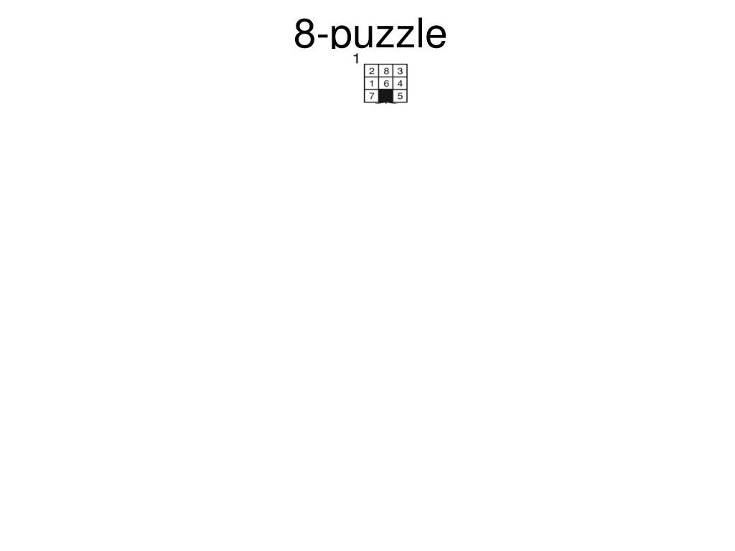

Slide 4
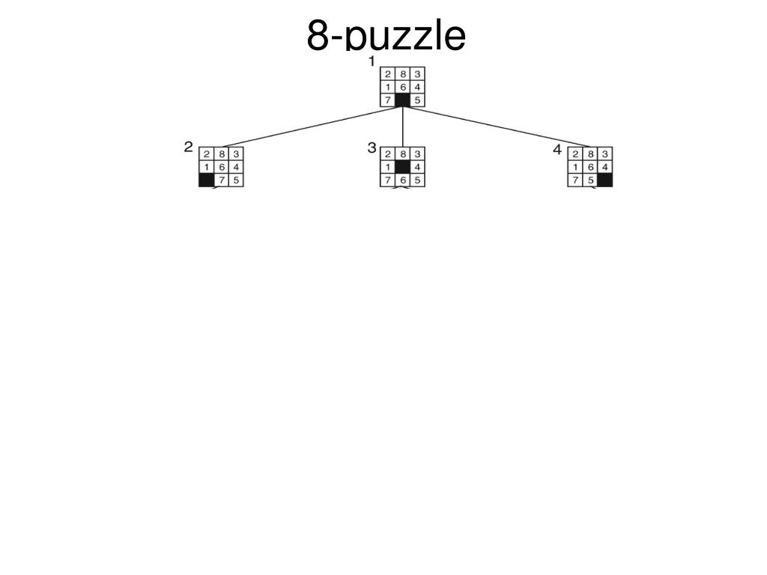

Slide 5
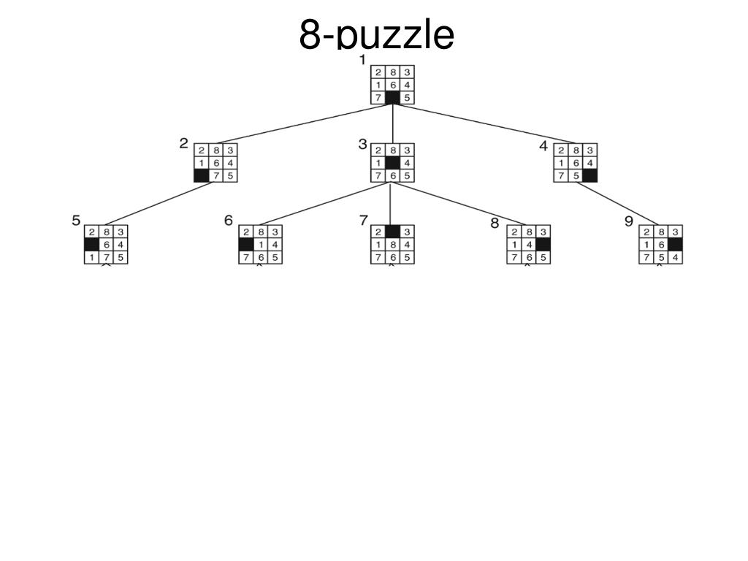

Slide 6
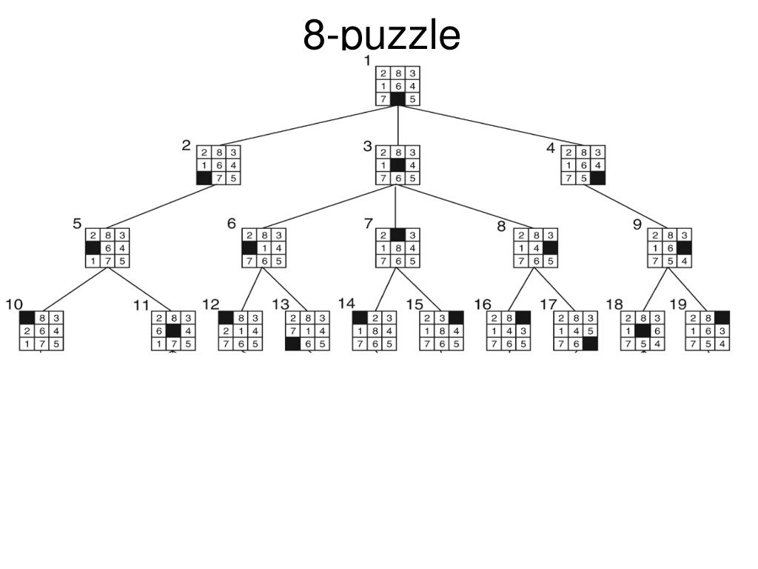

Slide 7
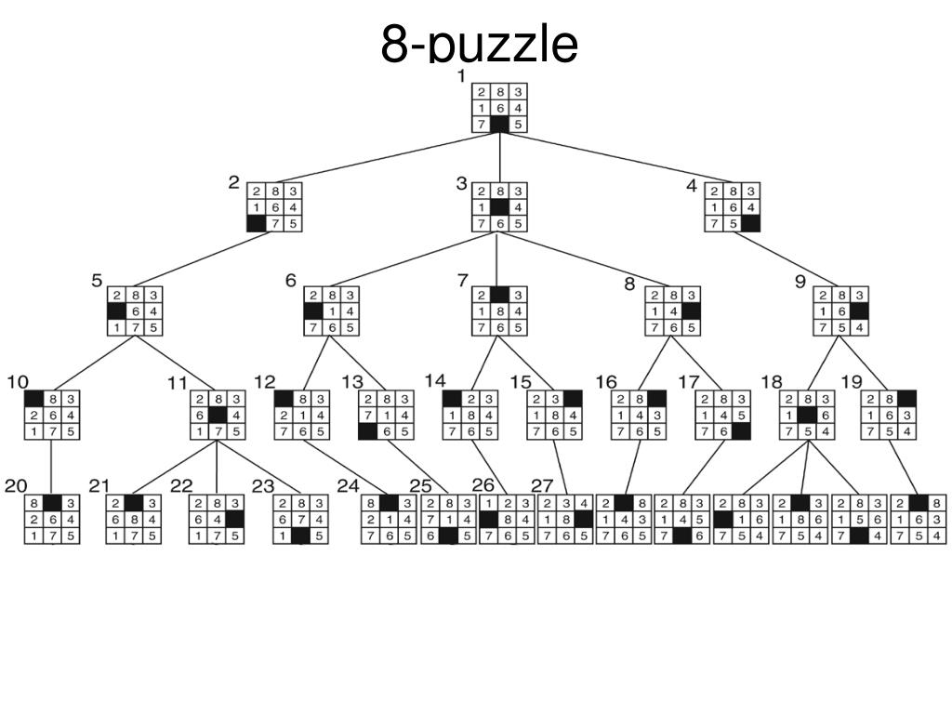

Slide 8
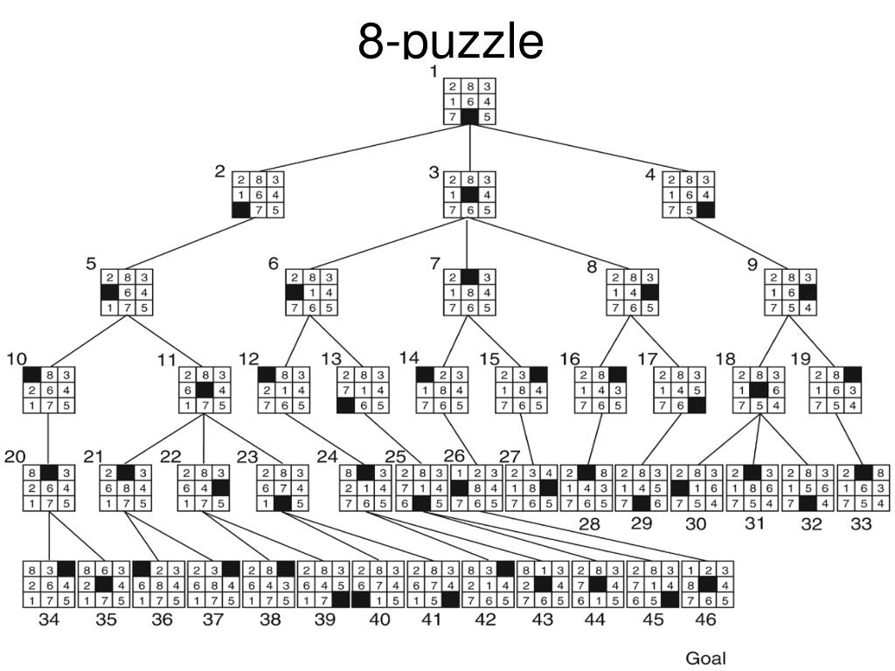

Slide 9
Maltab
Nodes= [];
NodesInfo=[]; % NodeInfo= [ Node #, Parent node #, CostToCome]
Nodes(:,:,1)= [1 2 3; 4 5 6; 7 8 0];
NodesInfo(:,:,1)= [1,0,0];
Nodes(:,:,2)= [1 2 3; 4 5 6; 7 0 8];
NodeInfo(:,:,2)= [2,1,0];
NodeSet. Nodes = Nodes;
NodeSet. NodesInfo = NodeInfo;
NodeSet. Nodes (:,:,2) % → Output [1 2 3; 4 5 6; 7 0 8];
Sub_functions:
[X0 Y0]=BlankTileLocation(CurrentNode);
[Status, NewNode] =ActionMoveLeft (CurrentNode)
[Status, NewNode] =ActionMoveRight (CurrentNode)
[Status, NewNode] =ActionMoveUp (CurrentNode)
[Status, NewNode] =ActionMoveDown (CurrentNode)
AddNode (NewNode)
Note: Generate 100,000 nodes
NumberofNodes= size (Nodes) ;
While NumberofNodes (3) <=100000

Slide 10
Due Date and Deliverables
Due date: February 23 , 6 p.m.
Email deliverables to the course instructor and TA
Deliverables:
Source code
Output matrices : Nodes and Nodesinfo
A word file that explains how to run the program
Note: Implementing a search algorithm to find the solution for this puzzle is optional

